Slide 1
Machine learning (particle) physics
ACME
Multi-variate analyzer
Results
Data
Bryan Ostdiek

Slide 2
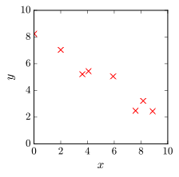
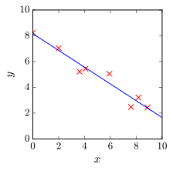
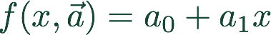
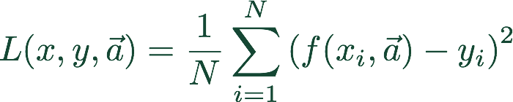
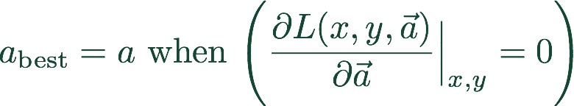
Review: Linear Regression
How to fit data
Plot the data
Define the function
Choose how to know what fits best
a.k.a. Loss Function
MSE:
Find the minimum error (loss) (cost)

Slide 3
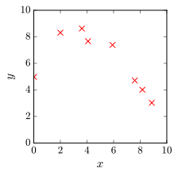
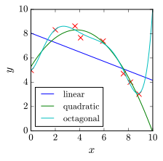
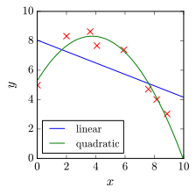
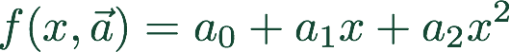


Quadratic?
Review: Linear Regression
How to fit data
Plot the data
Define the function
Choose how to know what fits best
a.k.a. Loss Function
MSE:
Find the minimum error (loss) (cost)
Is that good enough?
How many parameters can we add?
Avoid over fitting to be able to use for predictions

Slide 4

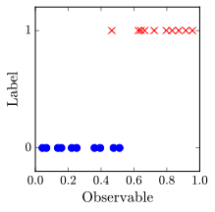
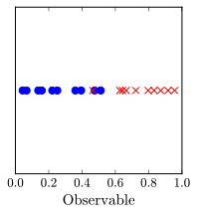
Logistic Regression
What if we are trying to predict a class, not a number?
quark(s)
gluon
What is the y-value we are trying to fit/predict?
Define one class as 1 (Signal)
Other class as 0 (Background)

Slide 5

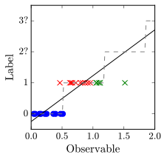
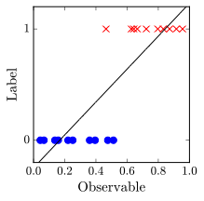
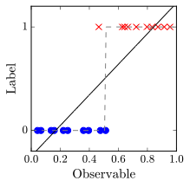
Logistic Regression
What if we are trying to predict a class, not a number?
Define one class as 1 (Signal)
Other class as 0 (Background)
Linear Fit?
Round to nearest number?
How does it generalize to more data?

Slide 6
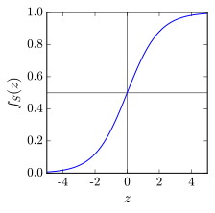
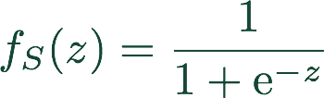

Logistic Regression
What if we are trying to predict a class, not a number?
Change the shape of function: Logistic/Sigmoid function
Does not add parameters
Change the loss function: BCE

Slide 7

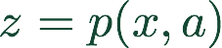



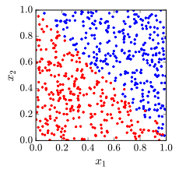
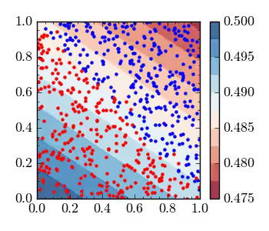
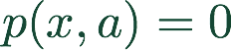


Logistic Regression
What if we are trying to predict a class, not a number?
What is ?
Large + values of
Minimize the loss with respect to
Boundary at
Large - values of

Slide 8
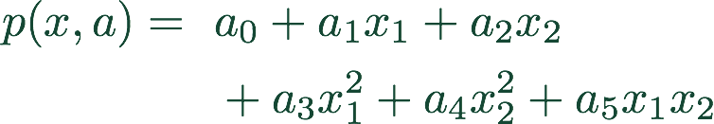
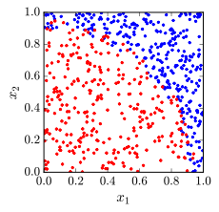
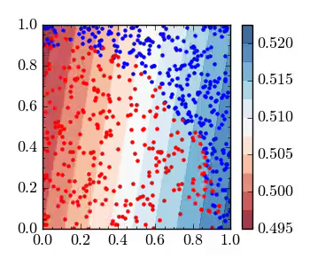
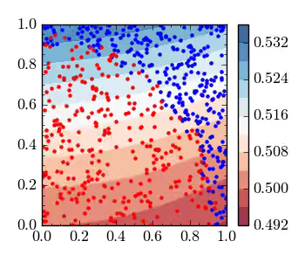
Logistic Regression
What if there is a shape in the data?

Slide 9

Regression Review
Can use nearly the same process for fitting a curve (predicting a number) or classification
Minimize a defined cost function
Easy to add parameters if shape is unknown — worry about over-fitting
If many inputs and complicated shapes, number of parameters necessary grows very quickly
Why use more complicated algorithms?

Slide 10
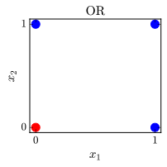
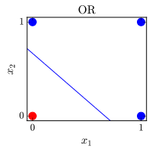


Neural Networks
OR
x1 x2 y
0
0
0
0
1
1
1
0
1
1
1
1

Slide 11
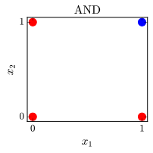
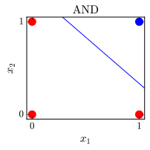

Neural Networks
AND
x1 x2 y
0
0
0
0
1
0
1
0
0
1
1
1

Slide 12

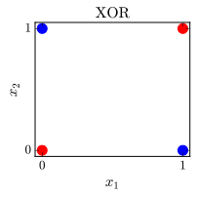
Neural Networks
OR
AND
x1 x2 y
x1 x2 y
0
0
0
0
0
0
0
1
1
0
1
0
1
0
1
1
0
0
1
1
1
1
1
1
XOR
x1 x2 y
0
0
0
0
1
1
This system cannot produce XOR
1
0
1
(cannot make a two sided cut)
1
1
0

Slide 13
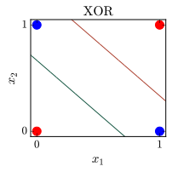
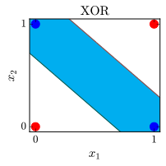



Neural Networks
XOR
x1 x2 y
0
0
0
0
1
1
1
0
1
1
1
0
AND
-20
20
-15
15
-15
NOT AND
-15
XOR
20
15
20
OR

Slide 14
Neural Networks
AND
XOR
x1 x2 y
-20
0
0
0
20
-15
15
0
1
1
-15
NOT AND
1
0
1
-15
XOR
20
15
1
1
0
OR
Simple example showing that neural network can access ‘high-level’ functions
To learn weights, need LARGE training set and CPU time

Slide 15
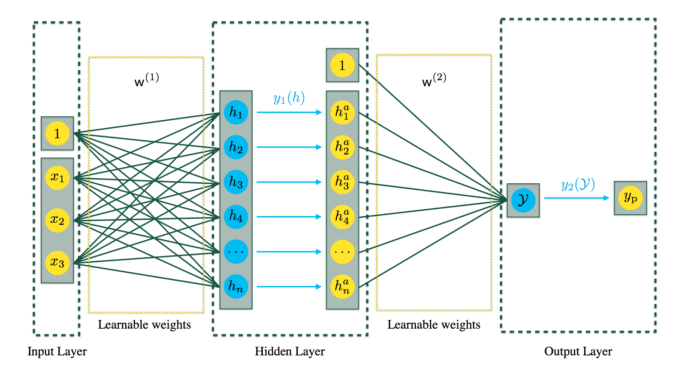
Neural Networks
Can be used in classifications and numerical predictions
Don’t add more inputs, let machine find own shape
Ability to learn ‘any’ function
More nodes/hidden layers allows for more complex features

Slide 16
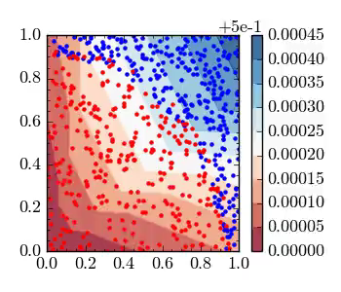
Neural Networks
Can be used in classifications and numerical predictions
Don’t add more inputs, let machine find own shape
Ability to learn ‘any’ function
More nodes/hidden layers allows for more complex features

Slide 17

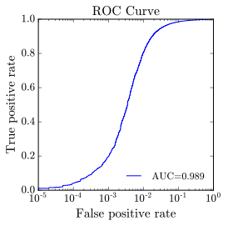
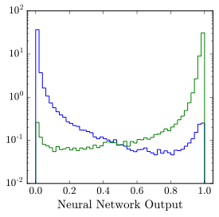
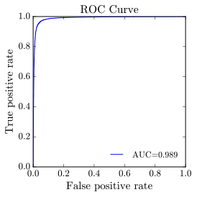
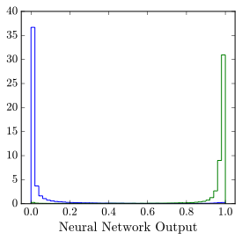
Measuring Classifiers
How good is the classifier?
AUC = 1.0 is perfect, this is not attainable for most problems

Slide 18











Particle Physics Interlude
Machine learning particle physics
Can identify and measure photons, electrons, muons, and things made of quarks
Energy and momentum vector
jets (b-jets)
Which heavy particle decayed to the final state particles?
Neutrinos (and some BSM particles) escape detection
Beams travel in ±z direction,
no momentum in (x, y) plane
Missing momentum in (x, y) plane

Slide 19
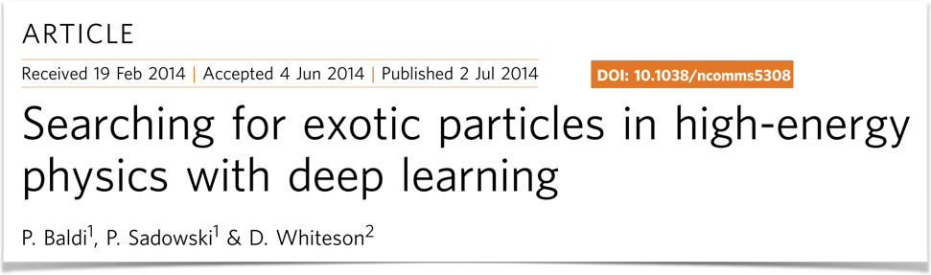
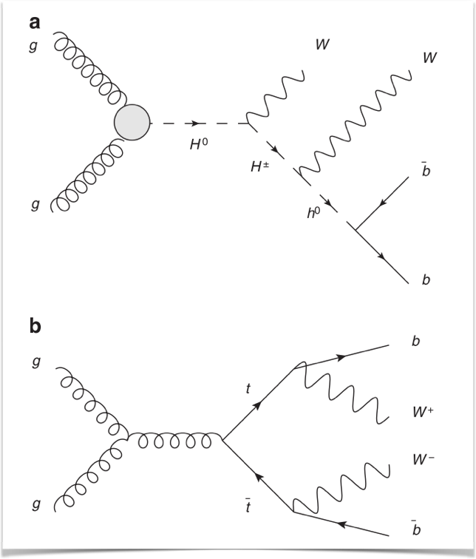

Neural Networks (Deep Learning)
[1402.4735]
One of first papers to show deep learning outperforming standard techniques in HEP
Compares shallow and deep networks on raw and high-level features

Slide 20

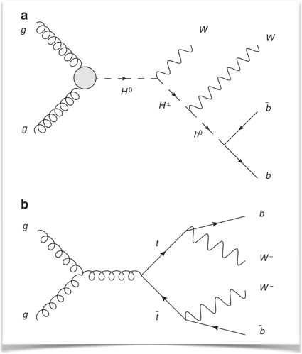

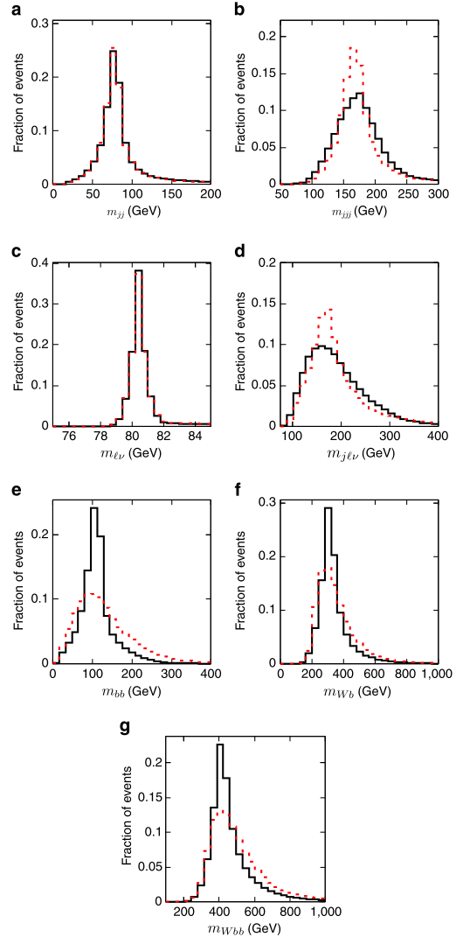
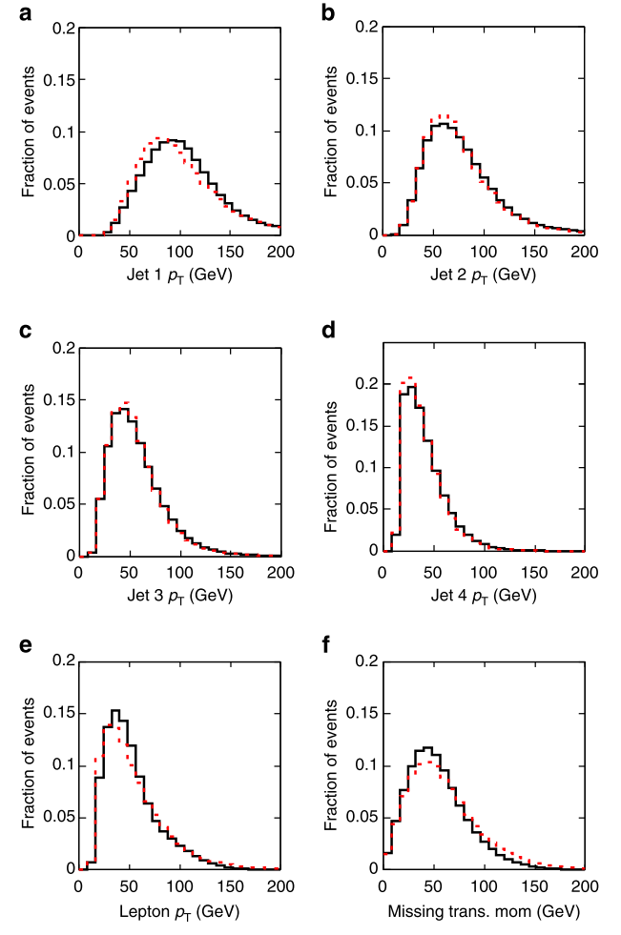
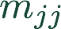


Neural Networks (Deep Learning)
21 raw features for semi-leptonic channel
Not much separation in individual features
Invariant masses of intermediate sates

Slide 21
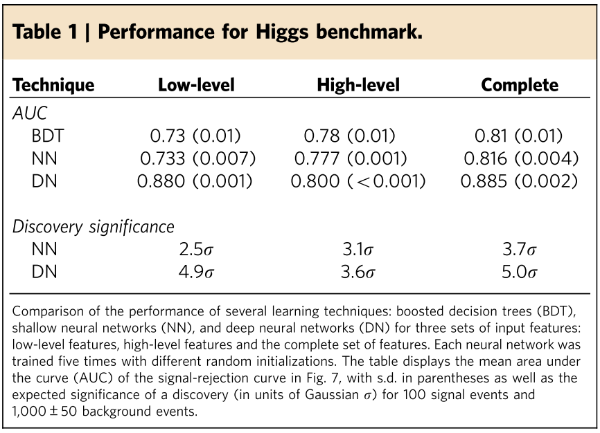





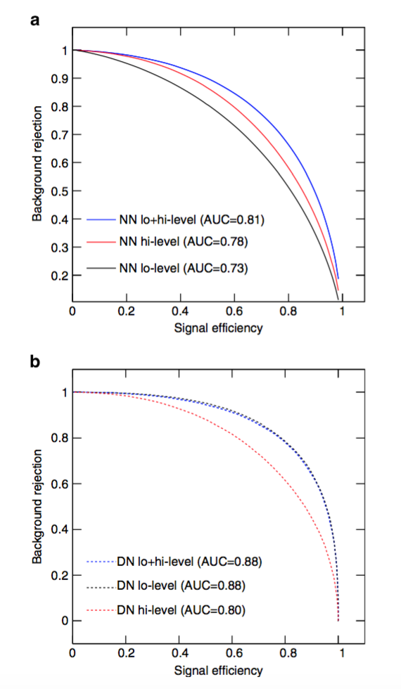
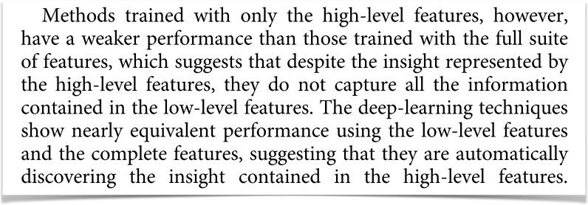



Neural Networks (Deep Learning)
11 million training examples
1 hidden layer shallow network
5 layer deep network

Slide 22
Resources
https://github.com/bostdiek/IntroToMachineLearning
https://www.coursera.org/learn/machine-learning/home/welcome
https://www.coursera.org/learn/neural-networks-deep-learning/home/welcome
http://scikit-learn.org/stable/#
https://www.kaggle.com
ACME
Multi-variate analyzer

